Slide 1

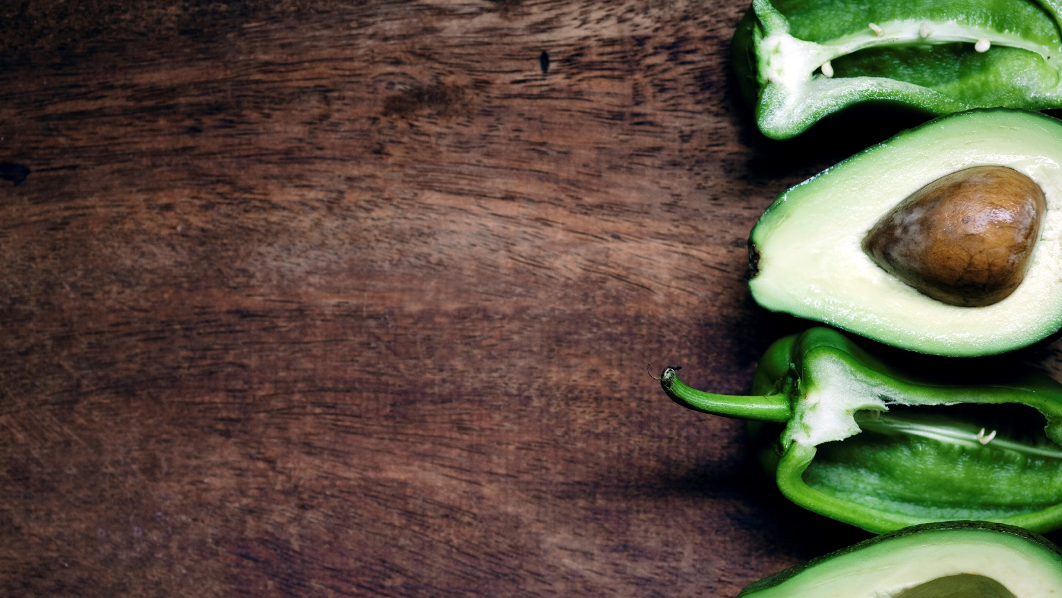
Website proposal
Maintain Fitness during Stay at Home

Slide 2
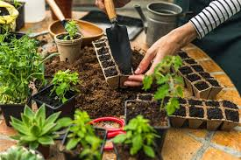
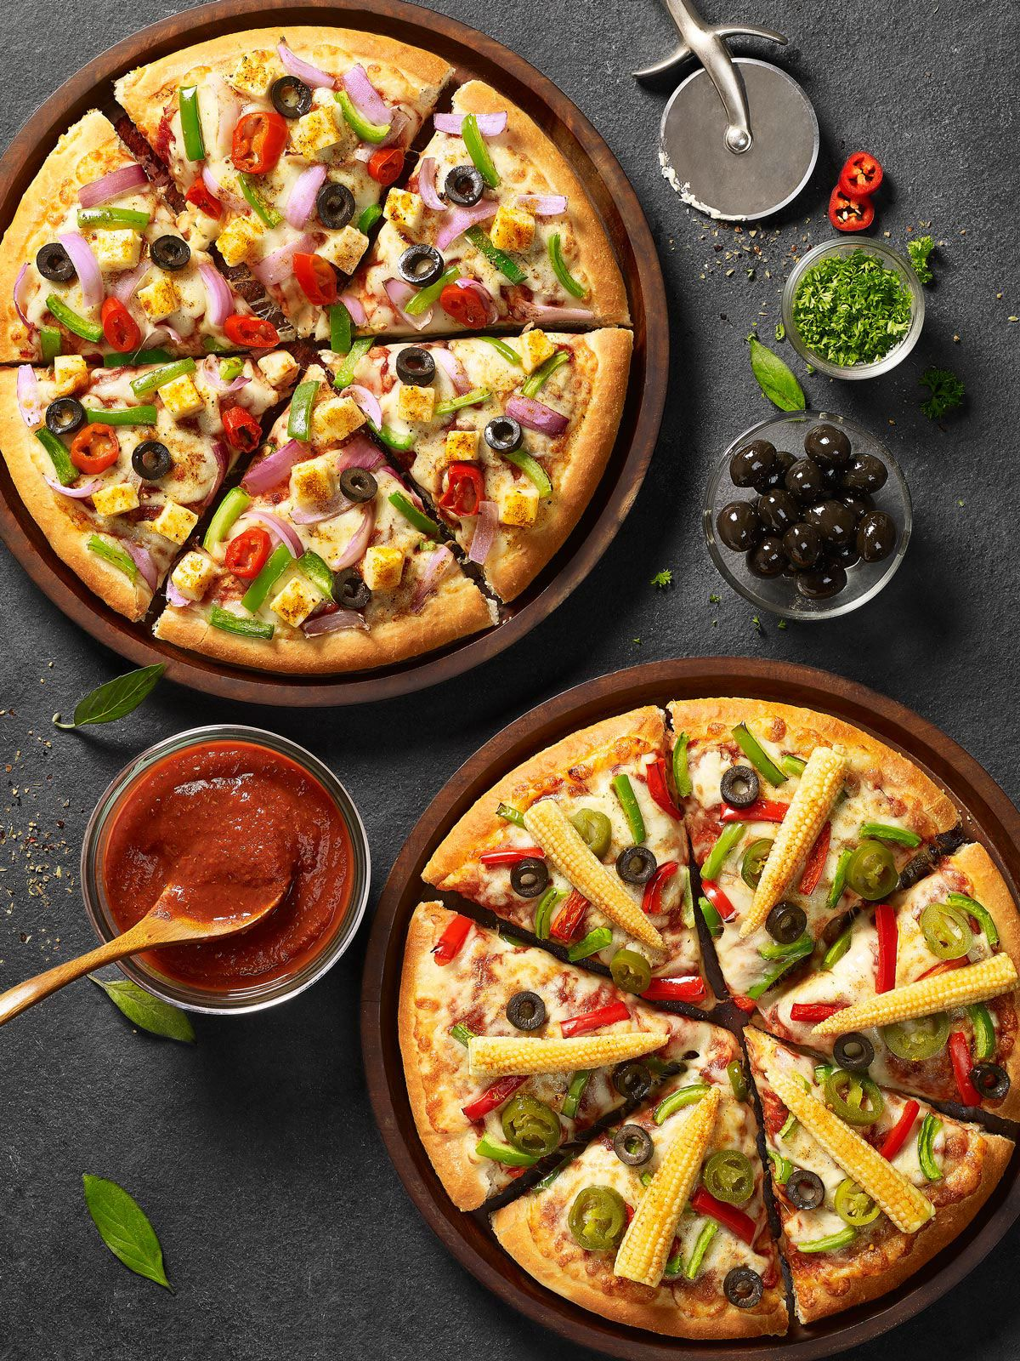

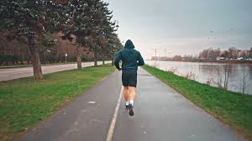
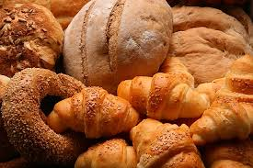
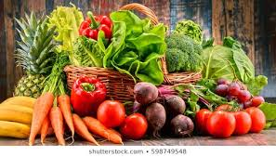

Our content
Website proposal
Target audience
Design Process
About us
Thank you
Site map

Slide 3
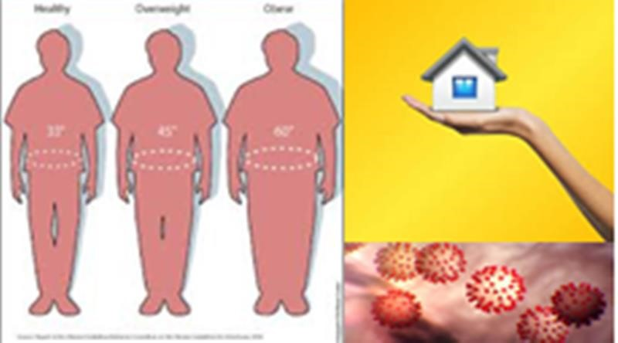
Website purpose
Today all are facing COVID-19 virus and people are in curfew period . So, people eat more food these days than previous days , do not work and exercise . Through this, they become fat and have to face many problems such as they have to be a diabetic or heart patients . They cannot meet their doctor in this period and cannot maintain their healthy and fitness.
Therefore, we thought to built a website for this problem and this website will serve the people to check their BMI value ,know about health and maintain their fitness

Slide 4

Target audience
Any people all over the world (Specially Growing age children and old people)

Slide 5

Design Process
Step 1- ANALYSIS
Collecting important information such as purpose, goal , target audience and detailed feature request
Step 2-SPECIFICATION
Writing of project brief including number of pages, color scheme functionalities and objective
Step 3–SITE STRUCTURE
Develop a site plan, wireframe, content structure and Navigation
Step 4- CONTENT
Keyboard research and content development
Step 5 – DESIGN
Mock-up design based on specification and content structure
Step 6 – DEVELOPMENT
Coding of template for each page, development of framework and implementing functionality as per approved design
Step 7 – TESTING
Verify all links and functionalities, user expiries testing and final polish of design element
Step 8 – LAUNCH
Transfer to live server, final cross-browser check and hand over to client

Slide 6
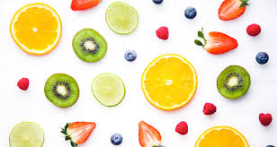
Site map
The following site map is proposed. The site map may change during the development of the website.
1. Home page- including an information, signup form , related news, social modules
2. About web-an outline of our web site to aid people finding our web pages
3. Calculate BMI-getting weight and height from user and calculating it, checking their fitness and giving advice related their BMI value
4. Blog-page for additional information about healthy life
5. Contact Us- including our team contact details such as phone numbers,emails

Slide 7
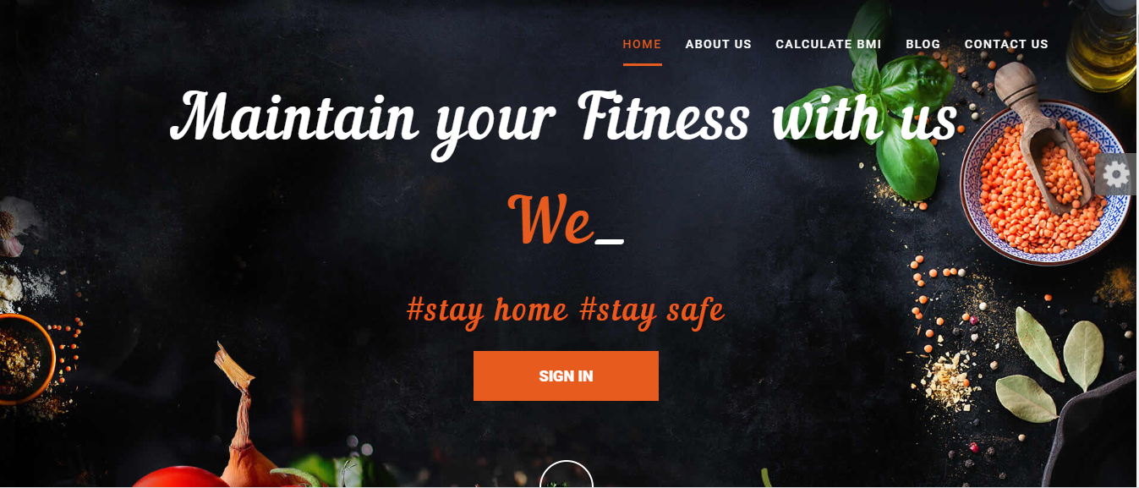
Home page

Slide 8
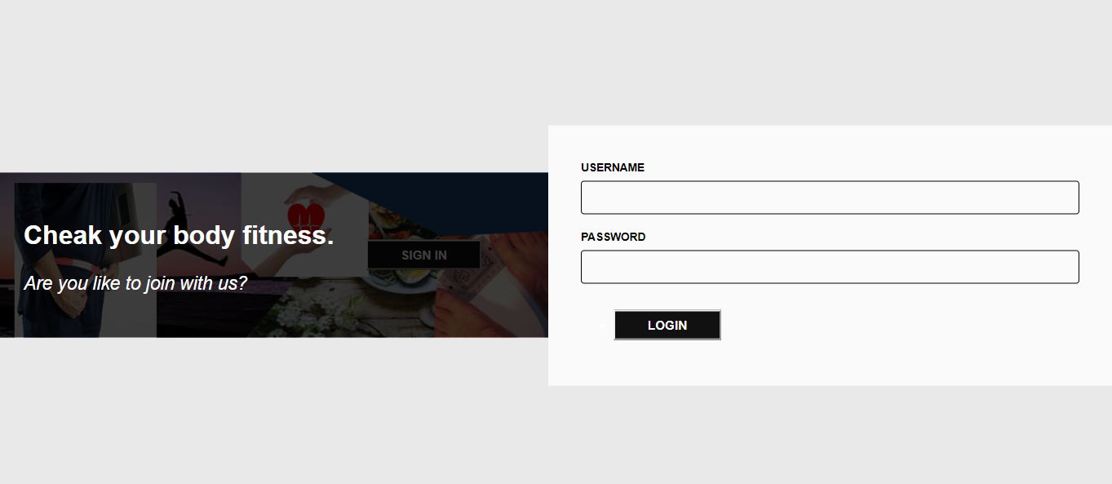
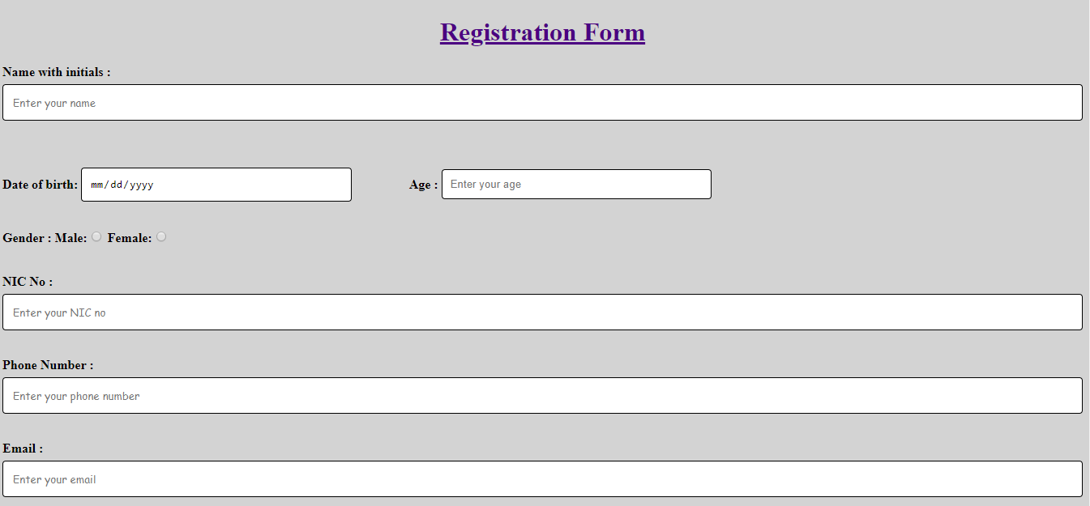
Then click on sign in button system give customer to registration form and he or she already a member of the site then give to login access to their account.
Click on sign in customer can get registration form like this

Slide 9
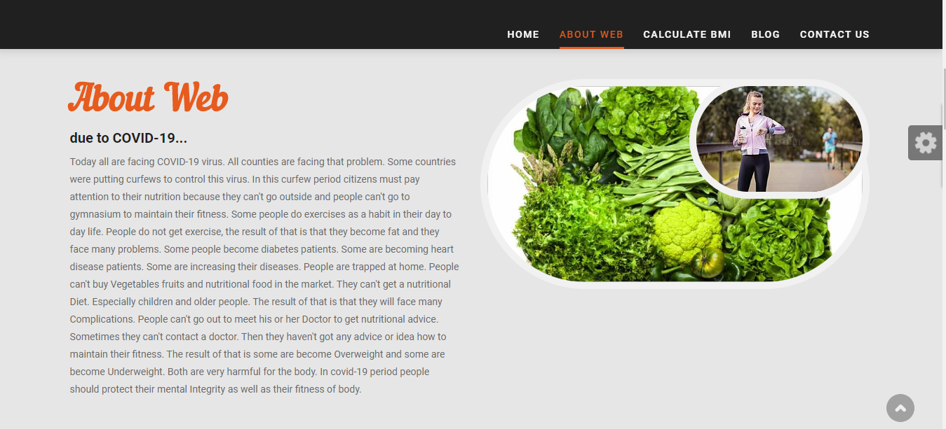
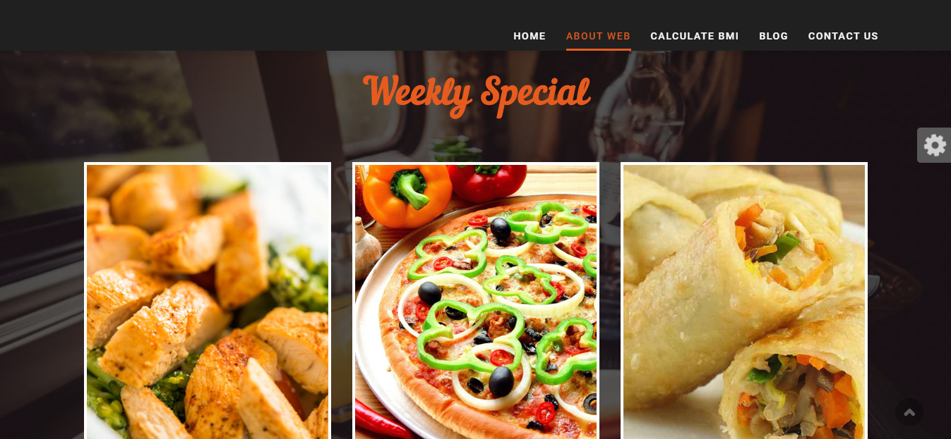
About web
We hope to give nutritional foods pictures and view a short description about that. Weekly we update it.

Slide 10
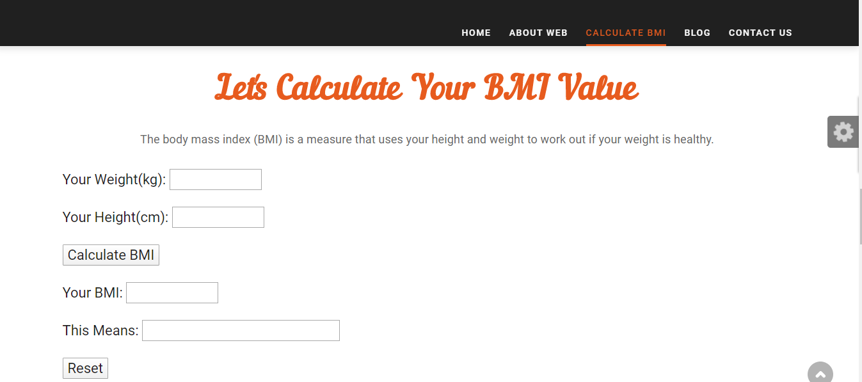
Calculate BMI
Every one can calculate BMI value using this but, any one has an account they can get their nutritional variance according to graph.

Slide 11
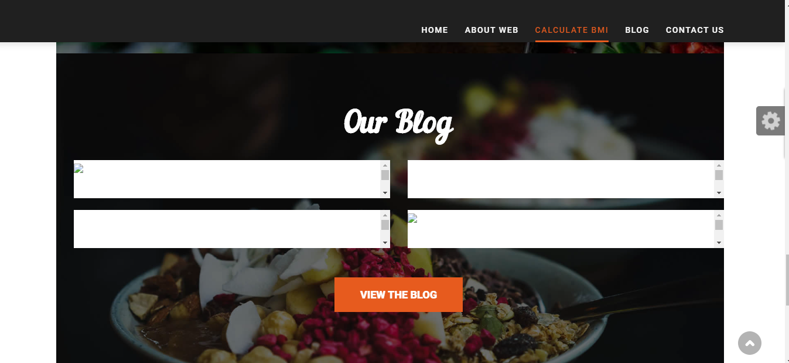
Blog
we hope to put activities and news to maintain healthy life.

Slide 12
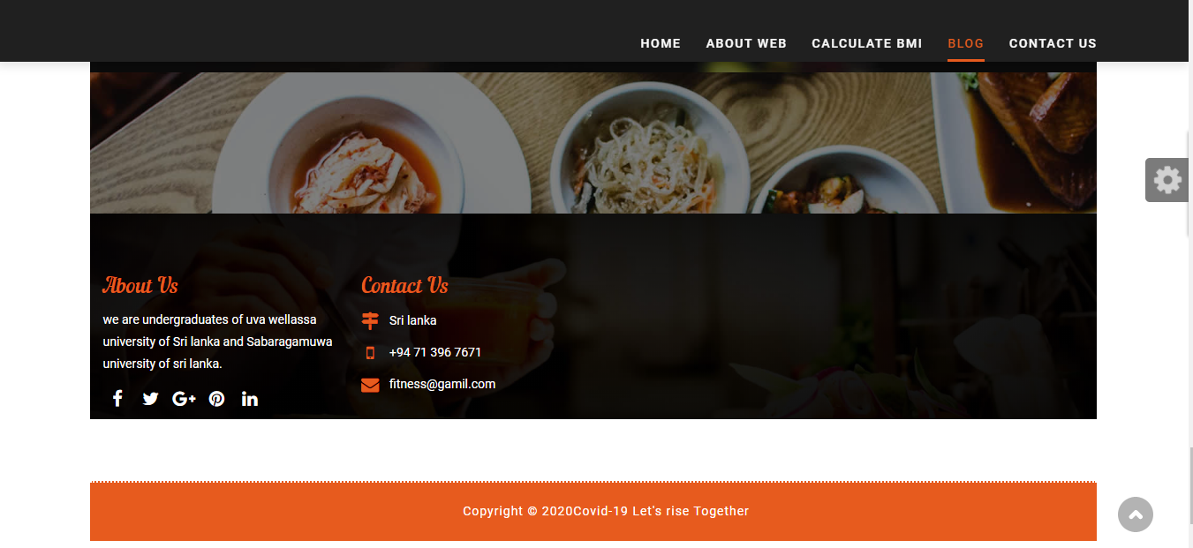
Contact us
Any one has any problem of that website, they can contact us using it’s information.

Slide 13

We used
1.html
2.CSS
3.Javascript
4.Boostrap
5.Dreamweaver
6.Photoshop
7.Php
8.Notepad++
We get some pictures from internet

Slide 14
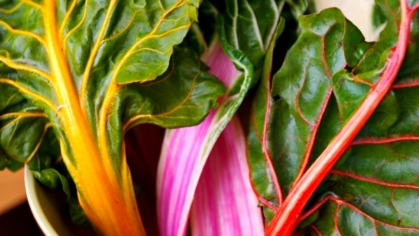
About us
Full Name: Hashini Nirasha Munasinghe
University: Uva Wellassa University of Sri Lanka
Contact Number: 071-3967671
Email: hashininirashamunasinghe@gmail.com
Full Name: Weligama Gamage Nirodha Weligama
University: Sabaragamuwa University of Sri Lanka
Contact Number: 070-3900710
Email: nirodha41@gmail.com

Slide 15

Thank you

